Slide 1



ACADEMIC PROJECT
REVIEW - II
Mentor : Dr. R.Rajeswara Rao
TEAM
R.S.S. HARIKA - 20VV1A0541
VENKAT CHOUDHARY – 20VV1A0503
CH. VIGNAN – 20VV1A0510
CH. MAHESH BABU – 21VV5A0569

Slide 2

CONTENTS
01
ARCHITECTURE
02
IN DETAILED APPROACHES
03
SYSTEM FLOW
04
OUR PROGRESS
05
CURRENT OBJECTIVES
06
ESTIMATED DATE OF COMPLETION

Slide 3
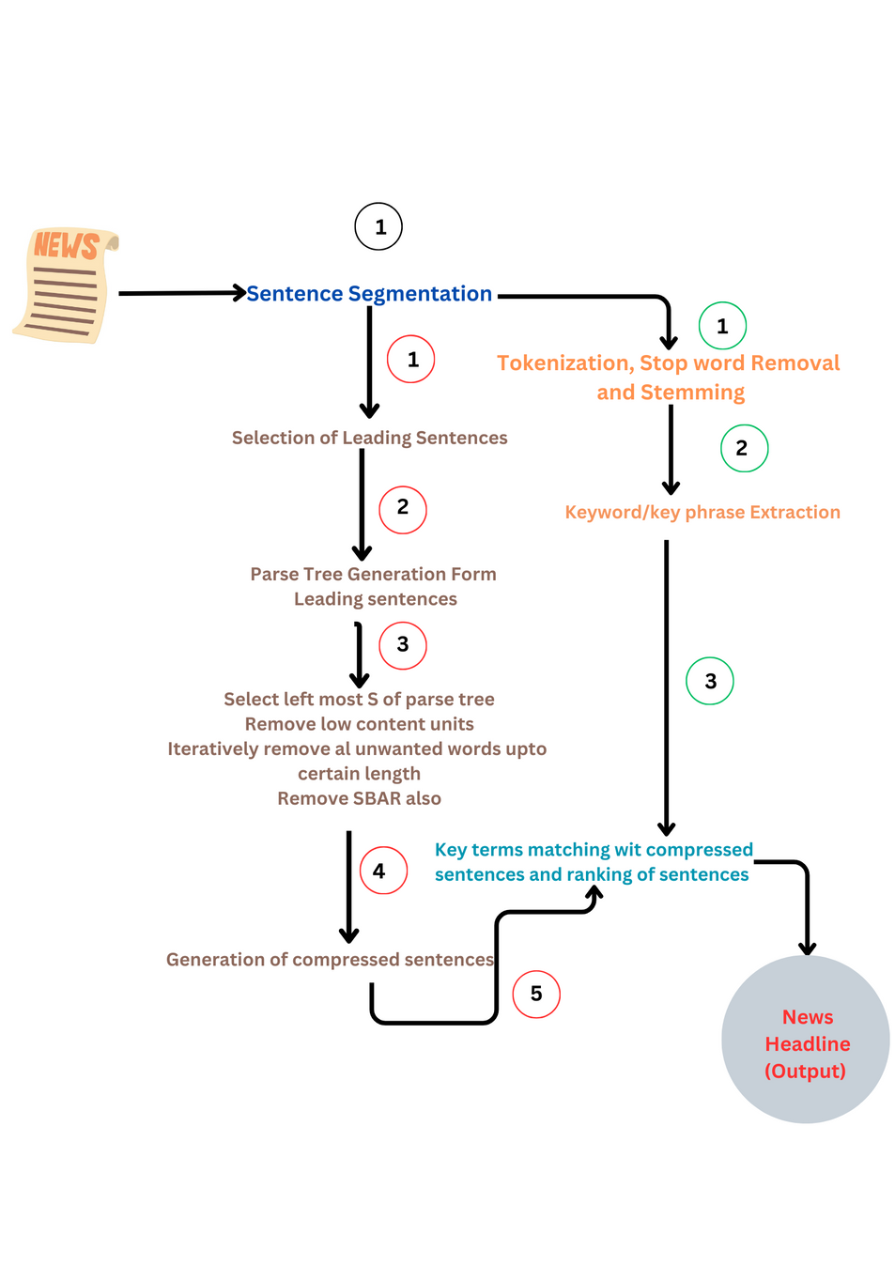
ARCHITECTURE

Slide 4
IN DETAIL...
PRE-PROCESSING
LOWERING THE SENTENCES
SENTENCE TOKENIZATION & WORDV TOKENIZATION
STEMMING
STOP WORD REMOVAL
KEYWORD EXTRACTION / KEYPHRASE EXTRACTION
TERM FREQUENCY – INVERSE DOCUMENT FREQUENCY
(TF-IDF)
LEADING SENTENCES EXTRACTION
TEXT RANK ALGORITHM (DERVED FROM PAGE RANK ALGORITHM OF GOOGLE)
PRE-PROCESSING
WORD2VEC
SIMILARITY MATRIX
TEXT RANK

Slide 5
IN DETAIL...
HERE WE ARE SELECTING THE NUMBER OF LEADING SENTENCES AS FOLLOWS :
BASED ON TEXT RANK ALGORITHM WE ARE COLLECTING A SENTENCE WITH RANK 1
(LEADING SENTENCE) FROM EACH PARAGRAPH IN AN ARTICLE.
IF THERE IS ONLY A SINGLE PARAGRAPH THEN THE NUMBER OF LEADING SENTENCES
WILL BE PROPOTIONAL TO NUMBER OF WORDS IN THE ARTICLE.
PARSE TREE GENERATION
GENERATE A SEMANTIC PARSE TREE ACCORDING TO THE SPECIFIED GRAMMAR (PARSE TREE CAN BE GENERATED FROM STANFORD PARSER)

Slide 6
IN DETAIL...
GENERAING COMPRESSED SENTENCES
REMOVE OR PRUNE THE PART OF PARSE TREE WHICH DON’T HAVE MAJOR IMPORTANCE AND PRODUCE COMPRESSED SENTENCES
MACHING KEYWORDS AND COMPRESSED SENTENCES AND RANKING OF SENTENCES
MATCHING THE KEY WORDS PRODUCES WITH COMPRESSED SENTENCES AND FORMING SEMANTICS AND RANKING THEM AND SELECTING THE SENTENCES WITH RANK 1 AS HEADLINE OF NEWS ARTICLE.( HEADLINE LENGTH IS BASED ON FREQUENCY DISTRIBUTION TABLE)

Slide 7
SYSTEM FLOW
Leading Sentence Generation
Body of the News Article
Pre-processing
Word2Vex
Similarity Matrix
Text Rank
Since the sentences are Ranked the sentence with Rank 1 will be choosen from every paragraph of article. If the article has only one sentence then number of leading sentences are propotional to num of words in article
Headline
Keywords Extraction using TF-IDF
Keyword-Extraction
Match the Keywords with Compressed Sentences and do Post-processing to generate semantically correct sentences. Assign Ranking to the sentences and select the sentence with Rank 1 As headline.
Parse tree Generation from Leading sentences
Each leading sentence will have a unique parse tree and a compressed sentence is produces from parse tree.
Output is Compressed
Sentences
Matching

Slide 8


OUR PROGRESS
01
02
03
04
05
06
PRE-PROCESSING
KEYWORD EXTRACTION
LEADING SENTENCE EXTRACTION
GRAMMAR DEFINITION AND
PARSE TREE GENERATION
SENTENCE COMPRESSION
KEYWORD MATCHING AND RANKING THE SENTENCES

Slide 9
CURRENT OBJECTIVES
Defining an accurate Grammar to produce a correct parse tree
Implementing various Parsing Algorithms to select a better Parsing Strategy for our system
Exploring various Data Resources to collect more data for the survey (Autonomous Headline Length selection and frequence distribution table creation)
Exploring Post-Processing Strategies

Slide 10
ESTIMATED DATE OF COMPLETION
APRIL 15,2024

Slide 11
THANK YOU

